Slide 1
SYSTEM ANALYSIS & DESIGN

Slide 2


Slide 3
THE CONTEXT OF SYSTEM ANALYSIS & DESIGN

Slide 4
Objectives:
Define information system and name several types of information system applications.
Identify different types of stakeholders who use or develop information systems, and give examples of each.
Define the role of systems analysts in the development of information systems.
Identify those skills needed to successfully function as an information system analyst.
Describe current business drivers that influence information systems development.
Describe current technology drivers that influence information systems development.
Briefly describe a simple process for developing information systems.
Notes:
No additional notes

Slide 5
SYSTEM

Slide 6
SYSTEM
The term system is derived from the Greek word "Systema”
Which means an organized relationship among functioning units or components.
A system is an orderly group of interrelated components linked together that function together to achieve a desired result.
Systems are created and designed to solve problems to achieve one or more objectives.
It is the combination of people, devices and methods interrelated in working towards a common goal.
The component may be simple or complex, basic or advanced.

Slide 7
Cont..
We come into daily contact with the transportation system, the telephone system, the accounting system, the production system, and, for over two decades, the computer system.
Similarly, The business system and of the organization as a system consisting of interrelated departments (subsystems) such as production, sales, personnel, and an information system.
There may be a single computer or even be a series of intelligence terminals linked to a mainframe.
Each component is a part of total system and has to share work of the system to achieve the intended goal.

Slide 8
The study of system concept has three basic implications:
A system must be designed to achieve a predetermined objective.
Interrelationships and interdependence must exist among the components.
The objectives of the organization as a whole have a higher priority than the objectives of its subsystems.

Slide 9
Characteristics of a System:
Organization
Interaction
Interdependence
Integration
Central Objective

Slide 10
SYSTEM ELEMENTS

Slide 11
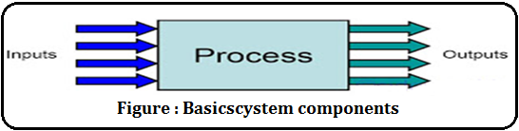
ELEMENTS OF A SYSTEM:
Basically there are three major components in every system, namely input, processing and output.
Every system has inputs and outputs and the systems analyst needs to identify the data input to the present system, and the data output.

Slide 12
ELEMENTS OF A SYSTEM:
Inputs and Outputs
Process
Control
Feedback
Environment
Boundaries and interface

Slide 13
Outputs and Inputs :
Inputs are the elements (material, human resources, information) that enter the system for processing.
Output is the outcome of processing.
A system feeds on input to produce output in much the same way that a business brings in human, financial, and material resources to produce goods and services.
Processor(s):
The processor is the element of a system that involves
the actual transfor­mation of input into output.
It is the operational component of a system.
Processors may modify the input totally or partially, depending on the specifications of the output.

Slide 14
Control :
The control element guides the system.
It is the decision-making subsystem that controls the pattern of activities governing input, processing, and output.
Feedback:
The Output is checked with the desired standards of the output set and the necessary steps are taken for achieving the output as per the standards, this process is called as Feedback.
Feedback may be positive or negative, routine or informational.

Slide 15
Environment:
The environment is the "supra system" within which an organization operates.
It often determines how a system must function.
The organization's environment, consisting of vendors, competitors, and others, may provide constraints and, consequently, influence the actual performance of the business
Boundaries and Interface:
The boundaries are nothing but the limit of the system.
Setting up boundaries helps for better concentration of the actives carried in the system.
System should be defined by its boundaries the limits that identify its components, processes, and interrelationships when it interfaces with another system.

Slide 16

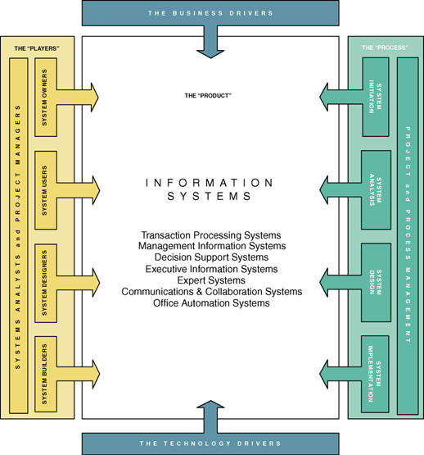
Notes:
Teaching Notes
This is the first “chapter map” for the book.
Each chapter will include a chapter map that visually maps the chapter to our adaptation of John Zachman’s Framework for Information Systems Architecture.
The complete map will be built over the course of the first three chapters.
Chapter 1 emphasizes the stakeholders column.
Conversion Notes
The map is presented in a larger format than in earlier editions.

Slide 17
TYPE OF SYSTEM:
Open System
Closed System
Man-Made System

Slide 18
SN | OPEN SYSTEM | CLOSED SYSTEM
1. | Open systems are the systems which allow users to contribute, manipulate, edit, use, reuse, create and alter contents or the actual programming of the system. | Closed systems are the systems which allow users to use contents and minimal modification to the actual system or program.
2. | The system which interacts with the environment is known as an Open system. | A system which doesn't interact with the outside environment is known as the closed system.
3. | An open system allows things to come and go from it | A closed system allows nothing to enter or leave it.
4. | In reality completely opened systems are common. | In reality completely closed systems are rare.
5. | Examples of open systems include Word press, Unix etc. | Examples of closed systems include library catalogue software, email software, Microsoft office, web browsers etc.

